Slide 1


Written by Michael Freitag, Maximilian Bandle, Tobias Schmidt, Alfons Kemper, and Thomas Neumann Presented by Jeremy Robichaud and Mohammadali Rahnama
Adopting Worst-Case Optimal Joins in Relational Database Systems

Slide 2
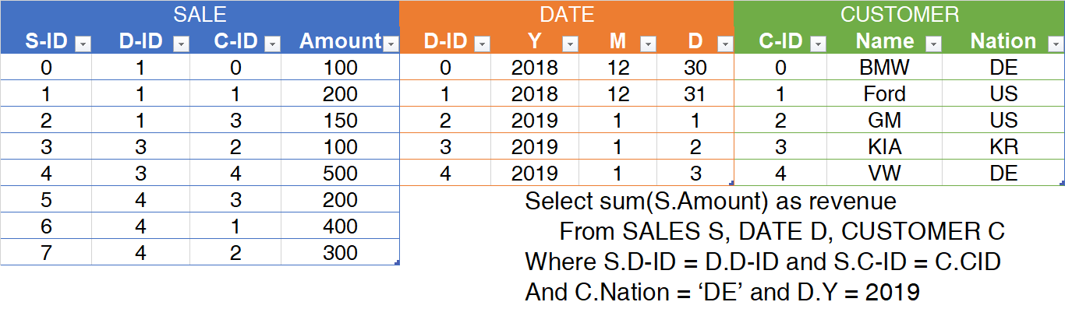
Problem statemensssst
Most traditional Relational Database Systems rely on binary joins to process queries that involve more than one relation.
The main shortcoming of binary joins is the generation of intermediate results that can become much larger than the actual query result.
Notes:
Calculate the total revenue from German customers in 2019

Slide 3
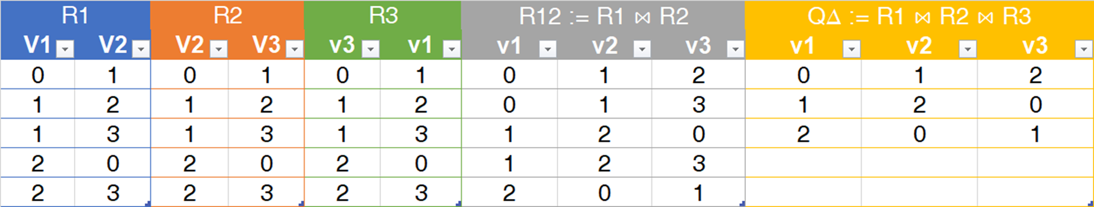
Problem statement (cont.)
Given Q∆ := R1(v1, v2) ⋈ R2(v2, v3) ⋈ R3(v3, v1), and R1=R2=R3
A traditional RDBMS will construct R1 ⋈ R2, then construct R12 ⋈ R3.
The intermediate step R12, will be much larger than the resultant query.
On some queries, traditional RDBMS that employ binary join plans frequently exhibit disastrous performance or even fail to produce any result at all.

Slide 4
Worst-Case Optimal Join
Therefore, there has been a long-standing interest in multi-way joins that avoid enumerating exploding intermediate results.
Worst-case optimal join algorithms offer better runtime than binary joins on certain types of queries.
They avoid enumerating large intermediate results by processing multiple input relations in a single multi-way join.
Systems that support worst-case optimal joins often focus on a specific problem domain, such as read-only graph analytic queries, where extensive precomputation can be used.

Slide 5
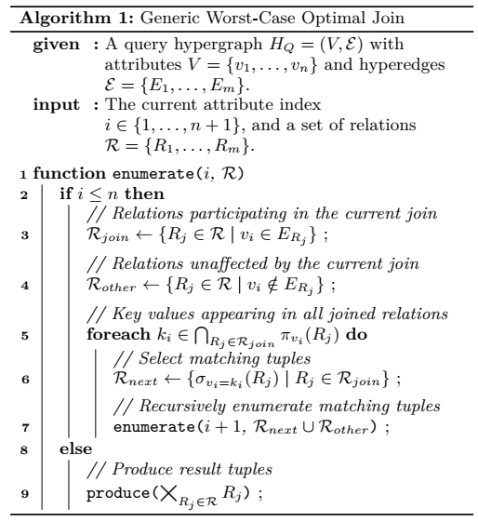
Worst-Case Optimal Join (cont.)
Generic Worst-Case Optimal Join operates on the query hypergraph HQ = (V; E) of a query Q.
Vertex set V contains the attributes V = {v₁; v₂; v₃}.
The edge set E contains the attribute sets of the individual relations R_{j}, E = {E₁; E₂; E₃}.
E₁ = {v₁; v₂}, E₂ = {v₂; v₃}, E₃ = {v₁; v₃}.

Slide 6
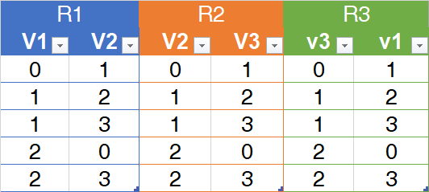
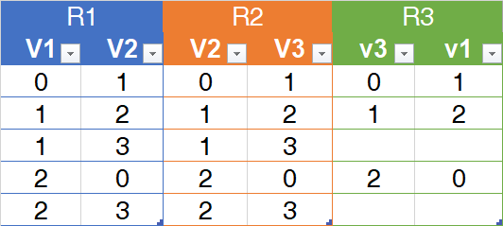
Worst-Case Optimal Join (cont.)
i = 1
R
R next

Slide 7

Worst-Case Optimal Join (cont.)
i = 2
R
R next

Slide 8

Worst-Case Optimal Join (cont.)
i = 3
R
R next

Slide 9
Proposed Hybrid Worst-Case Optimal Join
Existing implementations incur a sizable overhead in practice, primarily since they rely on suitable ordered index structures on their input.
The key component of the new approach is a novel hash-based worst-case optimal join algorithm that relies only on data structures.
The new join algorithm handles changing data transparently as any required data structures are built on-the-fly during query processing.
The proposed join processing approach can be split into clearly separated build and probe phases.

Slide 10
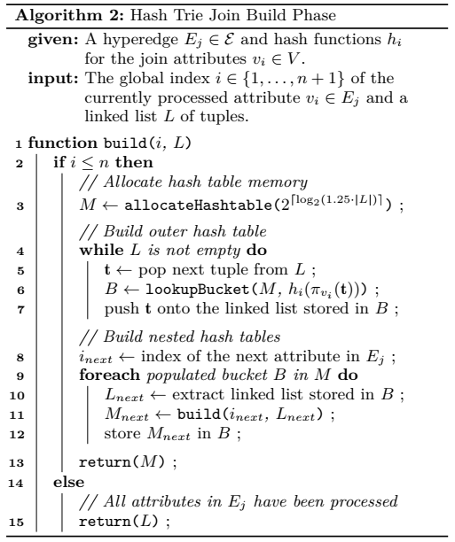
Build phase – Description
We first materialize all tuples in R_{j} in a linked list and pass them to the build Algorithm.
Its inputs are the global index i of the join attribute on which to build a hash table, and a linked list L of tuples.
Subsequently, the tuples in L are inserted into the hash table based on the hash value of the current join attribute v_{i}.

Slide 11
Build phase – Description (cont.)
Finally, the hash tables on the next join key attribute are built by calling the build Algorithm recursively on these linked lists.

Slide 12
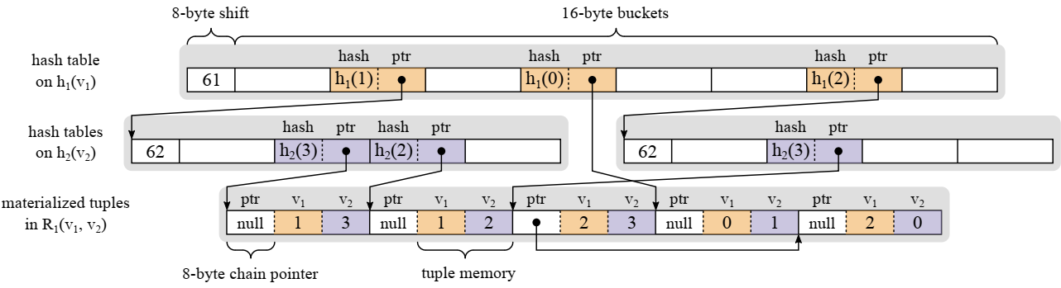
Build phase – Implementation
In the build phase, the incoming tuples are materialized contiguously in an in-memory buffer prior to running the Algorithm.
We assume that the size of a hash value is 64 bits, which is sufficient even for very large data sets.
The first 8 bytes of each bucket contain the full hash value that is stored in the bucket, which is required as we use linear probing to resolve collisions within the bucket array.

Slide 13
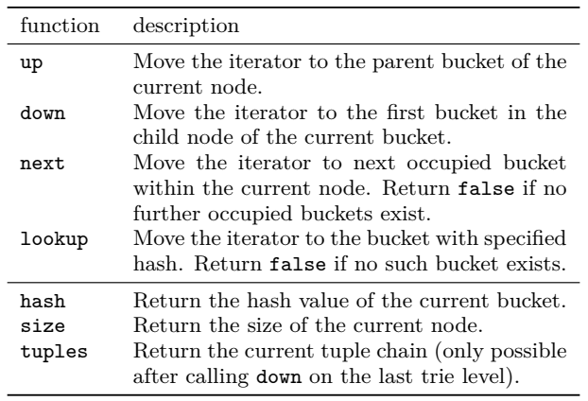
Probe phase – Description
The probe phase is responsible for enumerating the tuples in the join result of a query.
Our implementation accesses hash tries through iterators.
Iterators can be moved through a set of interface functions that allow horizontal navigation within the buckets of a given node (next, lookup), and vertical navigation between different nodes of the hash trie.

Slide 14
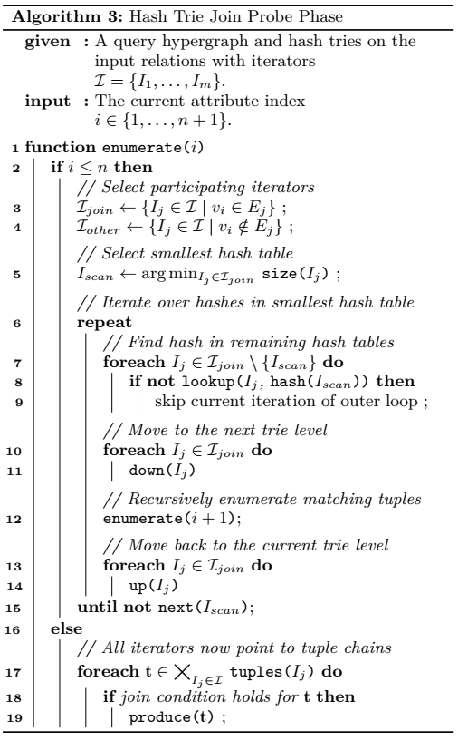
Probe phase - Implementation
From a high-level point of view our algorithm operates in exactly the same way as the generic algorithm,
However, with the key difference that it initially enumerates all tuples for which the hash values of the join keys match.
Any false positives arising due to hash collisions are filtered by a final check just before passing the tuples to the output consumer of the multi-way join operator
After the build phase, the initial hash trie structure for each input pipeline is available, and the join result can be computed Within the Umbra RDBMS

